Slide 1
Player Development

Slide 2
Why do your members/customers play golf?

Slide 3
Who Are You Marketing To??
Why Do You Play Golf?
Social & Entertainment
Competition & Sport
70% of golfers will place their dot in the middle or to the left of middle on this chart
How much of the focus is on this percentage of people?

Slide 4
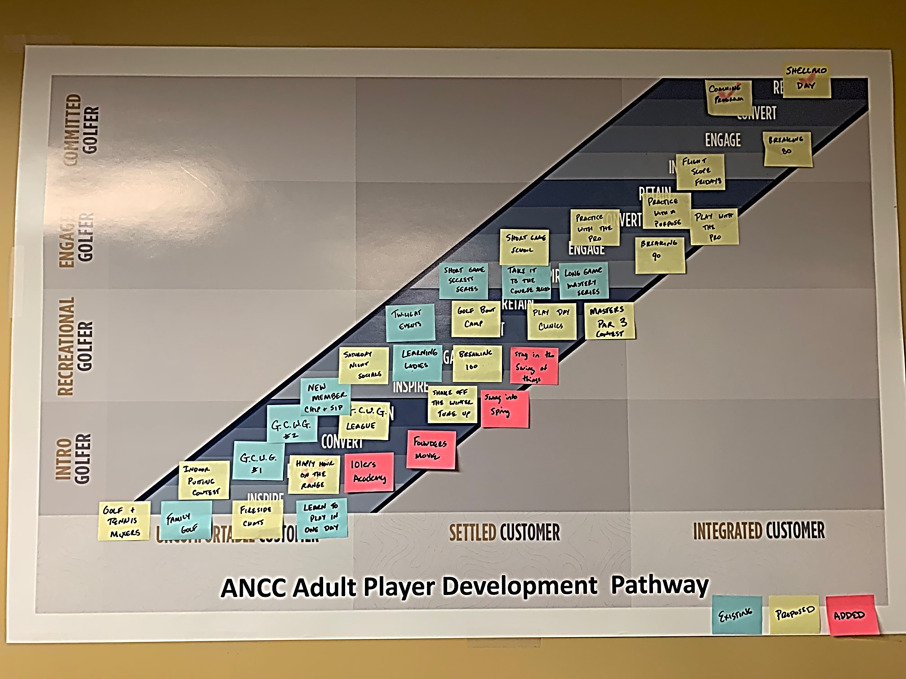
Once you determine why they play golf you can create programming they will support.

Slide 5
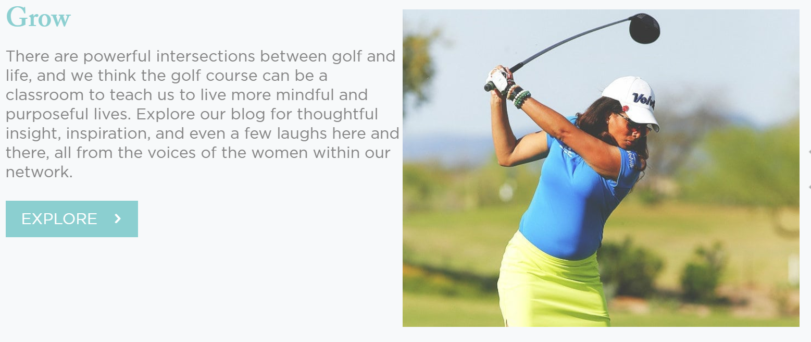
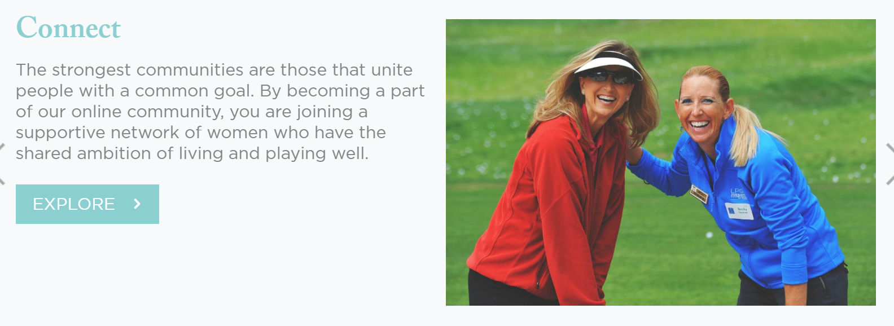
Create a Pathway in all Programming….
Invite Her
Golf 101
Women’s Golf Network

Slide 6
We Have Created The Programming Now
How Do We GEt Them To Participate?

Slide 7
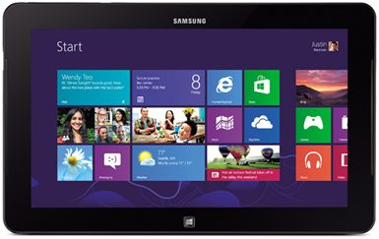
WHICH PRODUCT WOULD YOU PURCHASE?
HP is introducing a new tablet
It is the fastest and lightest tablet available
It has the most pixels
It is has the best camera
It is the least expensive
OR??

Slide 8
https://www.youtube.com/watch?v=3V2cfjwiSnE
https://www.youtube.com/watch?v=3V2cfjwiSnE

Slide 9
Start with the WHY not the WHAT
The WHY connects emotionally with customers Apple Example: Apple told us they would teach us to learn a new language or teach our children to spell Using a beautiful, easy to use Apple device It’s an iPad
WHY
HOW
WHAT

Slide 10
Traditional Golf Proposal
What
2. How
3. Why
Lessons
A System for Improvement
Better Golf,
More Fun

Slide 11
A New Opportunity
Why
2. How
3. What
Play Better and Have more Fun!
Improve your Skills
Game Plan for Improvement

Slide 12
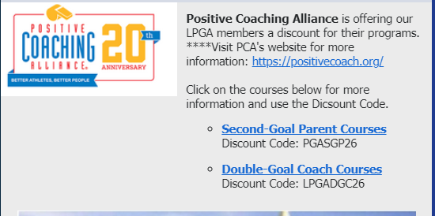
Which is more Effective?

Slide 13
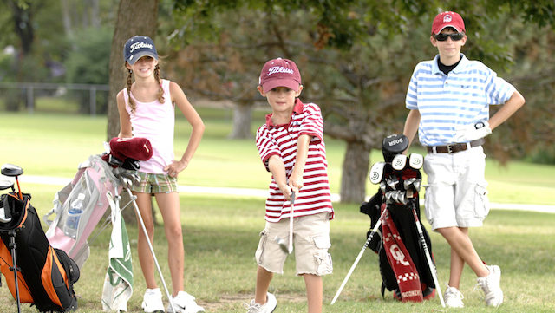
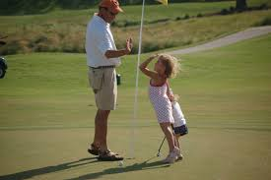
Are You A Coach? Do You Coach kids?
Would you like assistance in:
Developing better athletes and better people?
Gaining access to resources for youth and high school sports, coaches, parents administrators and student athletes?
Did you know that the LPGA has a partnership with the Positive Coaching Alliance? To find out more, including special pricing for members, click here.

Slide 14
What’s Your Value?

Slide 15
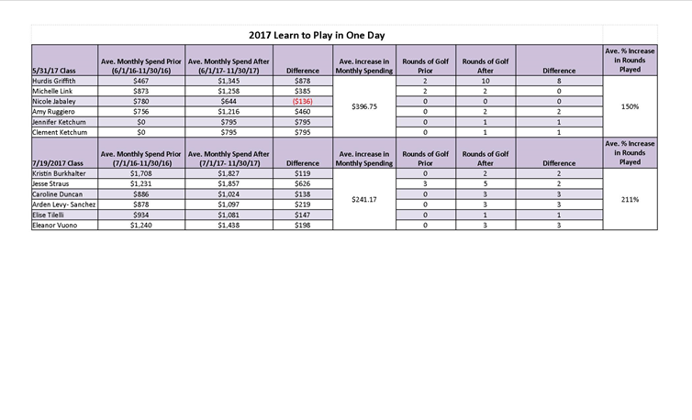
Player Development Math

Slide 16
Player Development Math
Program | Duration | Participants | Fee | Total | Hourly Rate
Learn to Play in One Day | 6 Hours | 6 | $325 | $1950 | $325
Get Comfortable with Golf | 5 Weeks | 6 | $175 | $1050 | $175
Get Comfortable with Golf Level 2 | 5 Weeks | 6 | $175 | $1050 | $175
Get Comfortable with Golf League | 90 Minutes | 30 | $25 | $750 | $562.50
Learning Ladies | 1 hour | 8 | $25 | $200 | $200

Slide 17
Recap:
Ask Them Why they Play
Build Programming Around What They Tell you
Market Your Programming Using The Why
Know Your Value

Slide 18
Questions?
Liz Cooper, LPGA, PGA Director of Player Development
Army Navy Country Club
Arlington, VA 22202
703-969-2465
Liz.Cooper@ancc.org

